Slide 1
UNIT-III
Optical Detectors and receivers

Slide 2
Photodetectors
The photodetector senses the luminescent power falling upon it and converts the variation of this optical power into a correspondingly varying electric current. Since the optical signal is generally weakened and distorted when it emerges from the end of the fiber, the photodetector must meet very high performance requirements.
The photodetector should also be insensitive to variations in temperature, be compatible with the physical dimensions of the optical fiber, have a reasonable cost in relation to the other components of the system, and have a long operating life.
Semiconductor-based photodetectors, the photodiode is used almost exclusively for fiber optic systems because of its small size, suitable material, high sensitivity, and fast response time.
The two types of photodiodes used are the pin photodetector and the avalanche photodiode.

Slide 3
Principles of Photodiodes
The pin Photodetector
The device structure consists of p and n regions separated by a very lightly n-doped intrinsic (i) region. In normal operation a sufficiently large reverse-bias voltage is applied across the device so that the intrinsic region is fully depleted of carriers.
As a photon flux penetrates into a semiconductor, it will be absorbed as it progresses through the material. Suppose Pin is the optical power level falling on the photodetector at x = 0 and P(x) is the power level at a distance x into the material. Then the incremental change dP(x) in the optical power level as this photon flux passes through an incremental distance dx in the semiconductor is given by
dP(x) = – as(l) P(x) dx,
where as(l) is the photon absorption coefficient at a wavelength l.

Slide 4
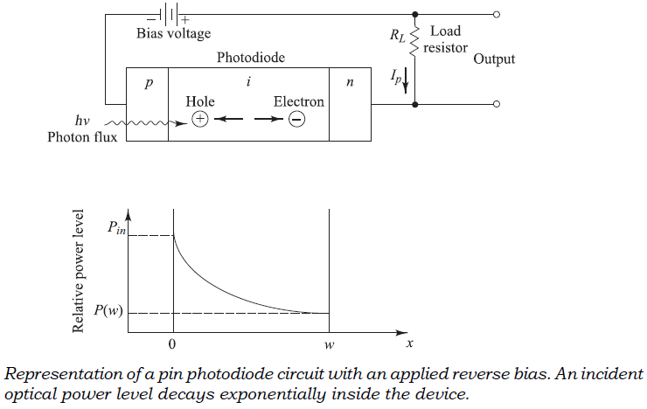
When an incident photon has an energy greater than or equal to the bandgap energy of the semiconductor material, the photon can give up its energy and excite an electron from the valence band to the conduction band.
This absorption process generates mobile electron–hole pairs. These electrons and holes are known as photocarriers, since they are photon-generated charge carriers that are available to produce a current flow when a bias voltage is applied across the device.

Slide 5
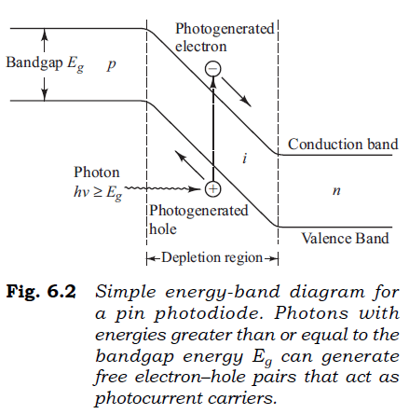
The photodetector is normally designed so that these carriers are generated mainly in the depletion region (the depleted intrinsic region) where most of the incident light is absorbed. The high electric field present in the depletion region causes the carriers to separate and be collected across the reverse-biased junction. This gives rise to a current flow in an external circuit, with one electron flowing for every carrier pair generated. This current flow is known as the photocurrent.

Slide 6
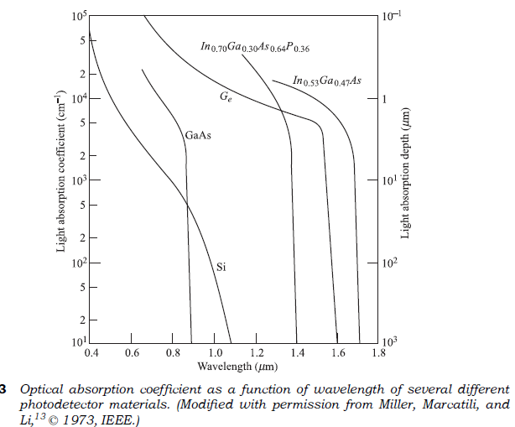
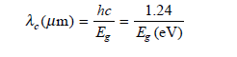
As the curves clearly show, as depends strongly on the wavelength. Thus a particular semiconductor material can be used only over a limited wavelength range. The upper wavelength cutoff lc is determined by the bandgap energy Eg of the material. If Eg is expressed in units of electron volts (eV), then lc is given in units of micrometers (mm) by,
The cutoff wavelength is about 1.06 mm for Si and 1.6 mm for Ge. For longer wavelengths, the photon energy is not sufficient to excite an electron from the valence to the conduction band.

Slide 7
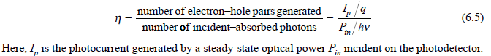
Two important characteristics of a photodetector are its
quantum efficiency and
its response speed.
These parameters depend on the material bandgap, the operating wavelength, and the doping and thickness of the p, i, and n regions of the device. The quantum efficiency h is the number of the electron–hole carrier pairs generated per incident–absorbed photon of energy hn and is given by

Slide 8
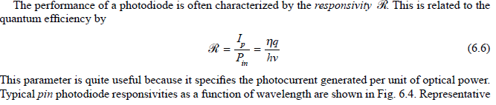
In a practical photodiode, 100 photons will create between 30 and 95 electron–hole pairs, thus giving a detector quantum efficiency ranging from 30 to 95 percent.
To achieve a high quantum efficiency, the depletion layer must be thick enough to permit a large fraction of the incident light to be absorbed. However, the thicker the depletion layer, the longer it takes for the photogenerated carriers to drift across the reverse biased junction. Since the carrier drift time determines the response speed of the photodiode, a compromise has to be made between response speed and quantum efficiency.

Slide 9
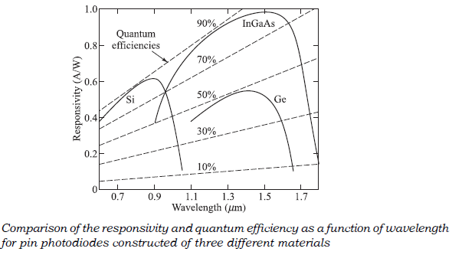
In most photodiodes the quantum efficiency is independent of the power level falling on the detector at a given photon energy. Thus the responsivity is a linear function of the optical power.
However, that the quantum efficiency is not a constant at all wavelengths because it varies according to the photon energy.
Consequently, the responsivity is a function of the wavelength and of the photodiode material (since different materials have different bandgap energies).
For a given material, as the wavelength of the incident photon becomes longer, the photon energy becomes less than that required to excite an electron from the valence band to the conduction band.

Slide 10
Avalanche Photodiodes
Avalanche photodiodes (APDs) internally multiply the primary signal photocurrent before it enters the input circuitry of the following amplifier. This increases receiver sensitivity, since the photocurrent is multiplied before encountering the thermal noise associated with the receiver circuit.
In order for carrier multiplication to take place, the photogenerated carriers must traverse a region where a very high electric field is present.
In this high-field region, a photogenerated electron or hole can gain enough energy so that it ionizes bound electrons in the valence band upon colliding with them. This carrier multiplication mechanism is known as impact ionization.
The newly created carriers are also accelerated by the high electric field, thus gaining enough energy to cause further impact ionization. This phenomenon is the avalanche effect.

Slide 11
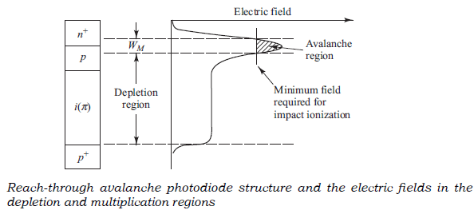
A commonly used structure for achieving carrier multiplication with very little excess noise is the reach-through construction.
The reach-through avalanche photodiode (RAPD) is composed of a high-resistivity p-type material deposited as an epitaxial layer on a p+ (heavily doped p-type) substrate.
A p-type diffusion or ion implant is then made in the high-resistivity material, followed by the construction of an n+ (heavily doped n-type) layer. For silicon, the dopants used to form these layers are normally boron and phosphorus, respectively. This configuration is referred to as p+ppn+ reach-through structure.

Slide 12
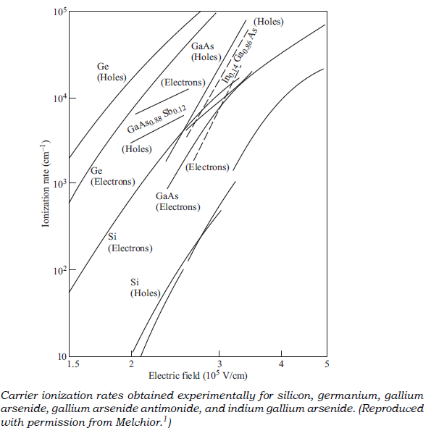
The average number of electron–hole pairs created by a carrier per unit distance traveled is called the ionization rate.
Most materials exhibit different electron ionization rates a and hole ionization rates b.
Experimentally obtained values of a and b for five different semiconductor materials are shown in Fig

Slide 13
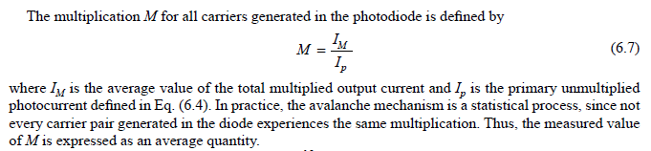
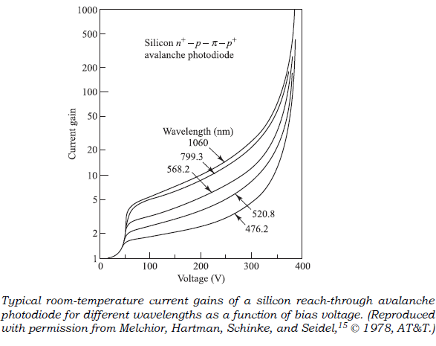
Typical current gains for different wavelengths as a function of bias voltage for a silicon reach-through avalanche photodiode are shown.
The dependence of the gain on the excitation wavelength is attributable to mixed initiation of the avalanche process by electrons and holes when most of the light is absorbed in the n+p region close to the detector surface.

Slide 14
Photodetector Noise

Slide 15
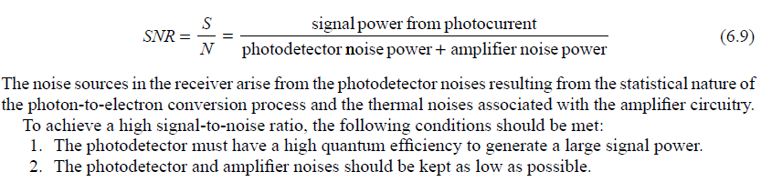
In fiber optic communication systems, the photodiode is generally required to detect very weak optical signals. Detection of the weakest possible optical signals requires that the photodetector and its following amplification circuitry be optimized so that a given signal-to-noise ratio is maintained. The power signal to-noise ratio S/N (also designated by SNR) at the output of an optical receiver is defined by
The sensitivity of a photodetector in an optical fiber communication system is describable in terms of the minimum detectable optical power. This is the optical power necessary to produce a photocurrent of the same magnitude as the root mean square (rms) of the total noise current, or equivalently, a signal to-noise ratio of 1.

Slide 16
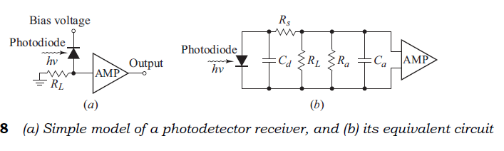
Noise Sources
The photodiode has a small series resistance Rs, a total capacitance Cd consisting of junction and packaging capacitances, and a bias (or load) resistor RL. The amplifier following the photodiode has an input capacitance Ca and a resistance Ra. For practical purposes, Rs is much smaller than the load resistance RL and can be neglected.

Slide 17
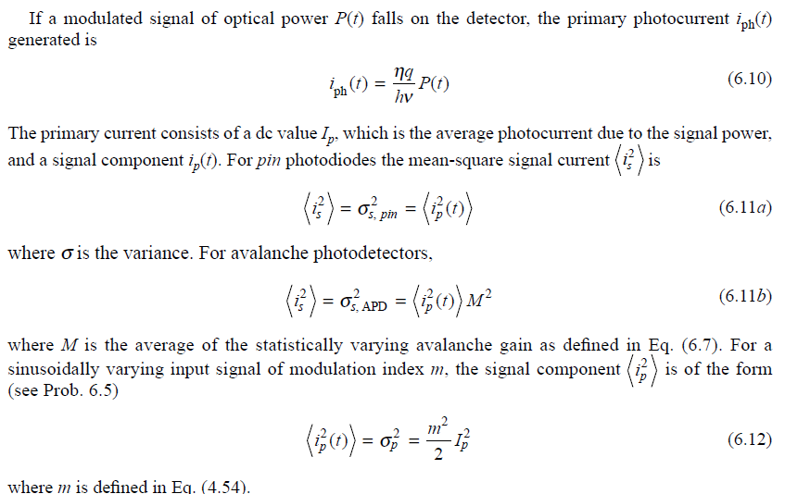

Slide 18
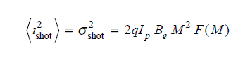
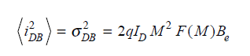
The principal noise sources associated with photodetectors that have no internal gain are quantum noise, dark-current noise generated in the bulk material of the photodiode, and surface leakage current noise.
The quantum or shot noise arises from the statistical nature of the production and collection of photoelectrons when an optical signal is incident on a photodetector. The shot noise current has a mean-square value in a receiver bandwidth Be that is proportional to the average value of the photocurrent Ip.
The photodiode dark current is the current that continues to flow through the bias circuit of the device when no light is incident on the photodiode.
This is a combination of bulk and surface currents. The bulk dark current iDB arises from electrons and/or holes that are thermally generated in the pn junction of the photodiode. The mean-square value of this current is given by

Slide 19
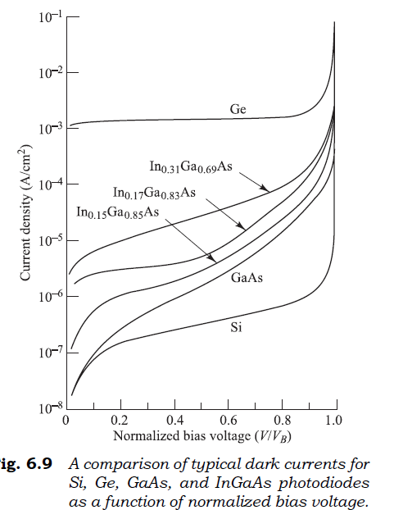
The surface dark current increases in proportion to the square root of the active area, and the bulk dark current is directly proportional to the area.
A comparison of typical dark currents for Si, Ge, GaAs, and InxGa1–xAs photo diodes is given in Fig. 6.9 as a function of applied voltage normalized to the break down voltage VB. Note that for InxGa1–xAs photodiodes the dark current increases with the composition x. Under a reverse bias, both dark currents also increase with the area.

Slide 20
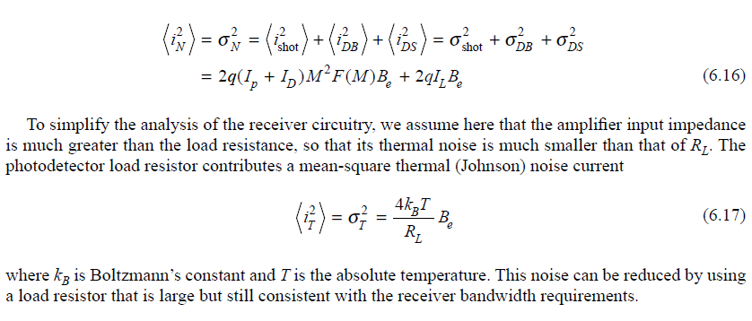
The total mean-square photodetector noise current iN 2 can be written as

Slide 21
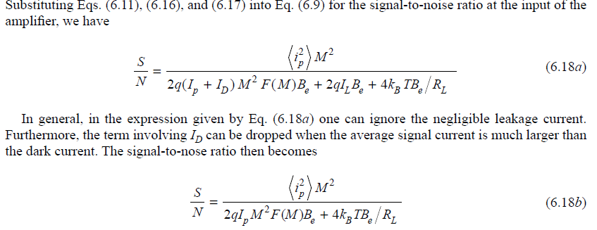
Signal-to-Noise Ratio
When the optical signal power is relatively high, then the shot noise power is much greater than the thermal noise power. In this case the SNR is called shot-noise limited or quantum limited. When the optical signal power is low, then thermal noise usually dominates over the shot noise. In this case the SNR is referred to as being thermal-noise limited.

Slide 22
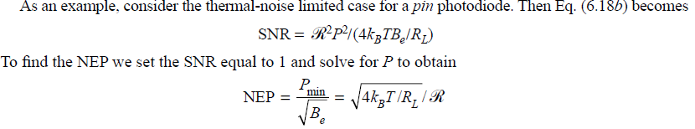
Noise-Equivalent Power
The sensitivity of a photodetector in an optical fiber communication system is describable in terms of the minimum detectable optical power. This is the optical power necessary to produce a photocurrent of the same magnitude as the root mean-square (rms) of the total noise current, or equivalently, a signal to-noise ratio of 1. This optical signal power is referred to as the noise equivalent power or NEP, which is designated in units of W Hz.

Slide 23
Detector Response Time

Slide 24
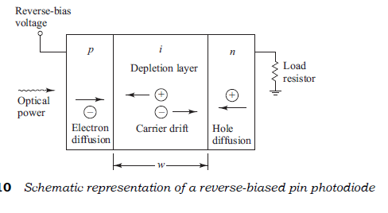
Depletion Layer Photocurrent
To understand the frequency response of photodiodes, let us first consider the schematic representation of a reverse-biased pin photodiode shown in Fig. Light enters the device through the p layer and produces electron–hole pairs as it is absorbed in the semiconductor material. Those electron–hole pairs that are generated in the depletion region or within a diffusion length of it will be separated by the reverse bias-voltage-induced electric field, thereby leading to a current flow in the external circuit as the carriers drift across the depletion layer.

Slide 25
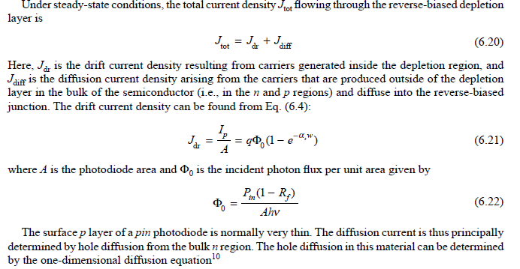

Slide 26
Response Time
The response time of a photodiode together with its output circuit depends mainly on the following three factors:
1. The transit time of the photocarriers in the depletion region.
2. The diffusion time of the photocarriers generated outside the depletion region.
3. The RC time constant of the photodiode and its associated circuit.
The photodiode parameters responsible for these three factors are the absorption coefficient as, the depletion region width w, the photodiode junction and package capacitances, the amplifier capacitance, the detector load resistance, the amplifier input resistance, and the photodiode series resistance.
The photodiode series resistance is generally only a few ohms and can be neglected in comparison with the large load resistance and the amplifier input resistance.

Slide 27
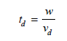
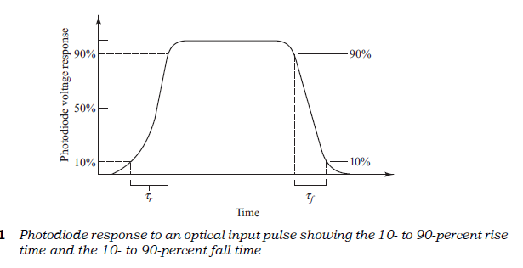
Let us first look at the transit time of the photocarriers in the depletion region. The response speed of a photodiode is fundamentally limited by the time it takes photogenerated carriers to travel across the depletion region. This transit time td depends on the carrier drift velocity vd and the depletion layer width w, and is given by
This response time is described by the rise time and fall time of the detector output when the detector is illuminated by a step input of optical radiation. The rise time tr is typically measured from the 10- to 90-percent points of the leading edge of the output pulse, as is shown in Fig.

Slide 28
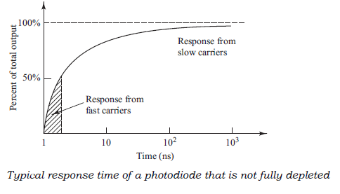
However, they can be different at low bias levels where the photodiode is not fully depleted, since the photon collection time then starts to become a significant contributor to the rise time. In this case, charge carriers produced in the depletion region are separated and collected quickly. On the other hand, electron–hole pairs generated in the n and p regions must slowly diffuse to the depletion region before they can be separated and collected. A typical response time of a partially depleted photodiode is shown in Fig.
The fast carriers allow the device output to rise to 50 percent of its maximum value in approximately 1 ns, but the slow carriers cause a relatively long delay before the output reaches its maximum value.

Slide 29
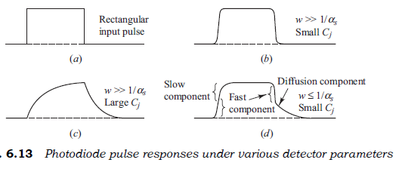
To achieve a high quantum efficiency, the depletion layer width must be much larger than l/as (the inverse of the absorption coefficient), so that most of the light will be absorbed. The response to a rectangular input pulse of a low-capacitance photodiode having w ? 1/as is shown in Fig. 6.13b. The rise and fall times of the photodiode follow the input pulse quite well. If the photodiode capacitance is larger, the response time becomes limited by the RC time constant of the load resistor RL and the photodiode capacitance. The photodetector response then begins to appear as that shown in Fig. 6.13c.

Slide 30
Comparisons of Photodetectors

Slide 31
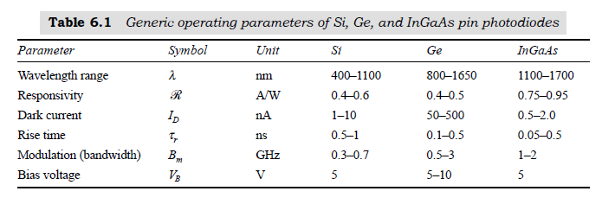

Slide 32
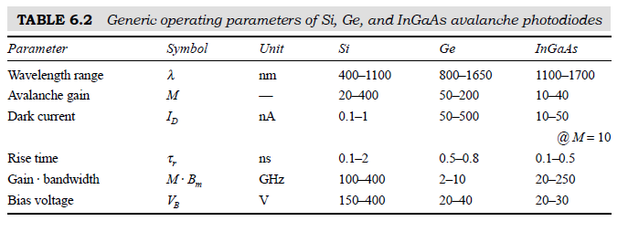

Slide 33
Optical Receiver Operation

Slide 34
The receiver has the task of first converting the optical energy emerging from the end of a fiber into an electric signal, and then amplifying this signal to a large enough level so that it can be processed by the electronics following the receiver amplifier.
In these processes, various noises and distortions will unavoidably be introduced, which can lead to errors in the interpretation of the received signal.
Depending on the magnitude of the received optical signal, the current generated by the photodetector could be very weak and is adversely affected by the random noises associated with the photo detection process.
When this electric signal output from the photodiode is amplified, additional noises arising from the amplifier electronics will further corrupt the signal.

Slide 35
Fundamental Receiver Operation
The design of an optical receiver is much more complicated than that of an optical transmitter because the receiver must be able to detect weak, distorted signals and make decisions on what type of data was sent based on an amplified and reshaped version of this distorted signal.
The optical signal that is coupled from the light source to the fiber becomes attenuated and distorted as it propagates along the fiber waveguide. Upon arriving at the end of a fiber, a receiver converts the optical signal back to an electrical format.
The first element is either a pin or an avalanche photodiode, which produces an electric current that is proportional to the received power level. Since this electric current typically is very weak, a front-end amplifier boosts it to a level that can be used by the following electronics.

Slide 36
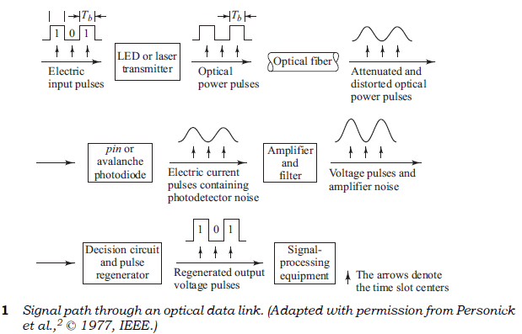
After the electric signal produced by the photodiode is amplified, it passes through a low-pass filter to reduce the noise that is outside of the signal bandwidth. This filter thus defines the receiver bandwidth.

Slide 37
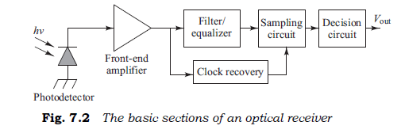
In addition, to minimize the effects of intersymbol interference (ISI) the filter can reshape the pulses that have become distorted as they traveled through the fiber. This function is called equalization because it equalizes or cancels pulse-spreading effects.
If the received signal level is greater than the threshold level, 1 is said to have been received. If the voltage is below the threshold level, 0 is assumed to have been received. To accomplish this bit interpretation, the receiver must know where the bit boundaries are. This is done with the assistance of a periodic waveform called a clock, which has a periodicity equal to the bit interval. Thus this function is called clock recovery or timing recovery.
In some cases, an optical preamplifier is placed ahead of the photodiode to boost the optical signal level before photodetection takes place. This is done so that the signal-to-noise ratio degradation caused by thermal noise in the receiver electron ics can be suppressed. Compared with other front-end devices, such as avalanche photodiodes or optical heterodyne detectors, an optical preamplifier provides a larger gain factor and a broader bandwidth.

Slide 38
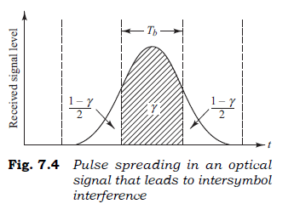
Error Sources
The term noise is used customarily to describe unwanted components of an electric signal that tend to disturb the transmission and processing of the signal in a physical system, and over which we have incomplete control. The noise sources can be either external to the system (e.g., electric power lines, motors, radio transmitters, lightning) or internal to the system (e.g., switch and power supply transients).
A further error source is attributed to intersymbol interference (ISI), which results from pulse spreading in the optical fiber. When a pulse is transmitted in a given time slot, most of the pulse energy will arrive in the corresponding time slot at the receiver, as shown in Fig.
However, because of pulse spreading induced by the fiber, some of the transmitted energy will progressively spread into neighboring time slots as the pulse propagates along the fiber. The presence of this energy in adjacent time slots results in an interfering signal, hence the term intersymbol interference.

Slide 39
Front-End Amplifier

Slide 40
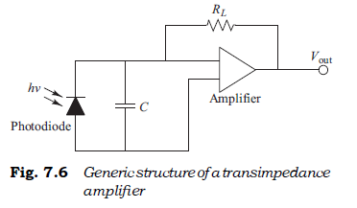
Noise sources at the front end of a receiver dominate the sensitivity and bandwidth, so a major engineering emphasis has been on the design of a low-noise front-end amplifier. The goals generally are to maximize the receiver sensitivity while maintaining a suitable bandwidth. Front-end amplifiers used in optical fiber communication systems can be classified into two broad categories, which are the high-impedance and the transimpedance designs.
The transimpedance amplifier design shown in Fig., largely overcomes the drawbacks of the high impedance amplifier. In this case, RL is used as a negative feedback resistor around an inverting amplifier. Now RL can be large since the negative feedback reduces the effective resistance seen by the photodiode by a factor of G, so that RP = RL/(G + 1), where G is the gain of the amplifier. This means that compared to the high-impedance design the transimpedance bandwidth increases by a factor of G + 1 for the same load resistance.

Slide 41
Although this does increase the thermal noise compared to a high-impedance amplifier, the increase usually is less than a factor of 2 and can easily be tolerated. Consequently, the transimpedance front-end design tends to be the amplifier of choice for optical fiber transmission links.
Note that in addition to the thermal noise differences resulting from selection of a particular load resistor, the electronic components in the front-end amplifier that follows the photodetector also add further thermal noise. The magnitude of this additional noise depends on the design of the amplifier, for example, what type of bipolar or field-effect transistors are incorporated in the design.
Typical values of the amplifier noise figure range from 3 to 5 dB (a factor of 2 to 3).

Slide 42
Digital Receiver Performance

Slide 43
Ideally, in a digital receiver the decision-circuit output signal voltage uout(t) would always exceed the threshold voltage when a 1 is present and would be less than the threshold when no pulse (a 0) was sent.
In actual systems, deviations from the average value of u out(t) are caused by various noises, interference from adjacent pulses, and conditions wherein the light source is not completely extinguished during a zero pulse.

Slide 44
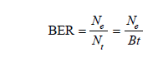
Probability of Error
In practice, there are several ways of measuring the rate of error occurences in a digital data stream. A simple approach is to divide the number Ne of errors occuring over a certain time interval t by the number Nt of pulses (ones and zeros) transmitted during this interval. This is called either the error rate or the bit-error rate, which is commonly abbreviated BER.
Thus we have
where B = 1/Tb is the bit rate (i.e., the pulse transmission rate). The error rate is expressed by a number, such as 10–9, for example, which states that, on the average, one error occurs for every billion pulses sent. Typical error rates for optical fiber telecommunication systems range from 10–9 to 10–12. This error rate depends on the signal-to-noise ratio at the receiver. The system error rate requirements and the receiver noise levels thus set a lower limit on the optical signal power level that is required at the photodetector.

Slide 45
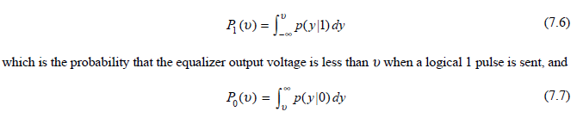
To compute the bit-error rate at the receiver, we have to know the probability distribution of the signal at the equalizer output. Knowing the signal probability distribution at this point is important because it is here that the decision is made as to whether a 0 or a 1 is sent. The shapes of two signal probability distributions are shown in Fig. 7.7. These are
which is the probability that the output voltage exceeds u when a logical 0 is transmitted. Note that the different shapes of the two probability distributions in Fig. indicate that the noise power for a logical 0 is usually not the same as that for a logical 1. This occurs in optical systems because of signal distortion from transmission impairments (e.g., dispersion, optical amplifier noise, and distortion from nonlinear effects) and from noise and ISI contributions at the receiver.
The functions p( y | l) and p( y | 0) are the conditional probability distribution functions; that is, p( y | x) is the probability that the output voltage is y, given that an x was transmitted.

Slide 46
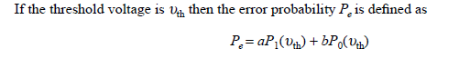
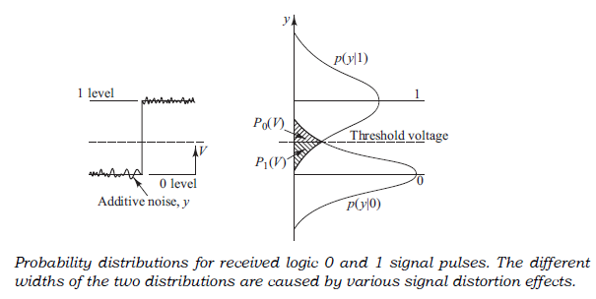
The weighting factors a and b are determined by the a priori distribution of the data. That is, a and b are the probabilities that either a 1 or a 0 occurs, respectively. For unbiased data with equal probability of 1 and 0 occurrences, a = b = 0.5. The problem to be solved now is to select the decision threshold at that point where Pe is minimum.

Slide 47
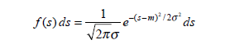
Error probability
Thus, to calculate the error probability, we need only to know the mean and standard deviation of u out(t).
Thus, let us assume that a signal s (which can be either a noise disturbance or a desired information bearing signal) has a gaussian probability distribution function with a mean value m. If we sample the signal voltage level s(t) at any arbitrary time t1, the probability that the measured sample s(t1) falls in the range s to s + ds is given by
where f(s) is the probability density function, s 2 is the noise variance, and its square root s is the standard deviation, which is a measure of the width of the probability distribution. By examining Eq. (7.9) we can see that the quantity 2 2σ measures the full width of the probability distribution at the point where the amplitude is 1/e of the maximum.

Slide 48
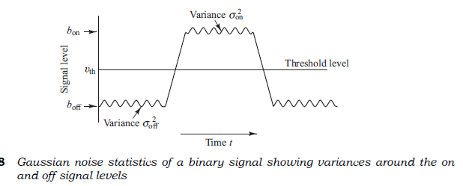
We can now use the probability density function to determine the probability of error for a data stream in which the 1 pulses are all of amplitude V. As shown in Fig, the mean and variance of the Gaussian output for a 1 pulse are b on and s 2 on, respectively, whereas for a 0 pulse they are b off and s 2 off , respectively.
Let us first consider the case of a 0 pulse being sent, so that no pulse is present at the decoding time.

Slide 49
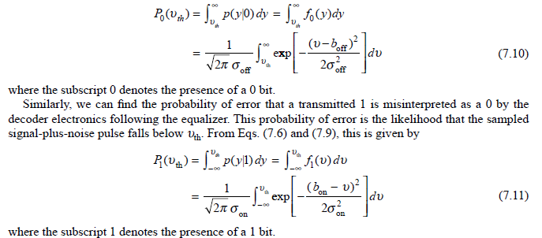
The probability of error in this case is the probability that the noise will exceed the threshold voltage
uth and be mistaken for a 1 pulse. This probability of error P0(u) is the chance that the equalizer output voltage u(t) will fall somewhere between uth and •. Using Eqs. (7.7) and (7.9), we have

Slide 50
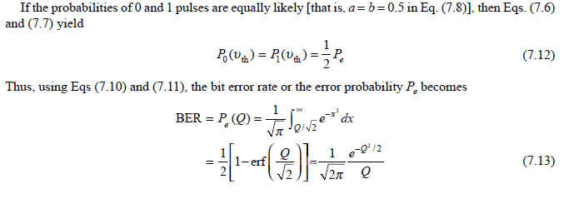

Slide 51
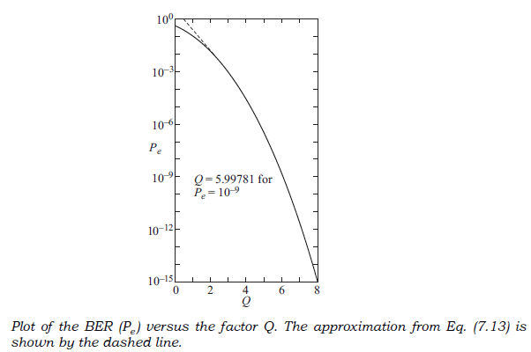
The factor Q is widely used to specify receiver performance, since it is related to the signal-to-noise ratio required to achieve a specific bit-error rate. In particular, it takes into account that in optical fiber systems the variances in the noise powers generally are different for received logical 0 and 1 pulses.
Figure 7.9 shows how the BER varies with Q. The approximation for Pe given in Eq. (7.13) and shown by the dashed line in Fig. 7.9 is accurate to 1 percent for Q a 3 and improves as Q increases. A commonly quoted Q value is 6, since this corresponds to a BER = 10–9.

Slide 52
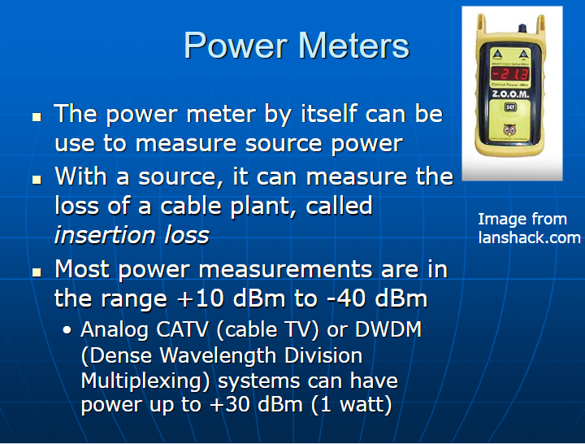

Slide 53
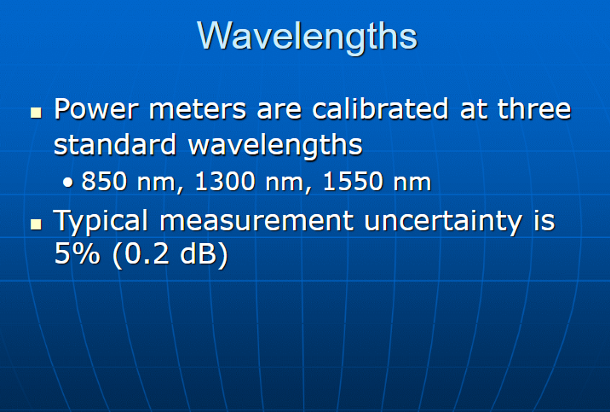

Slide 54
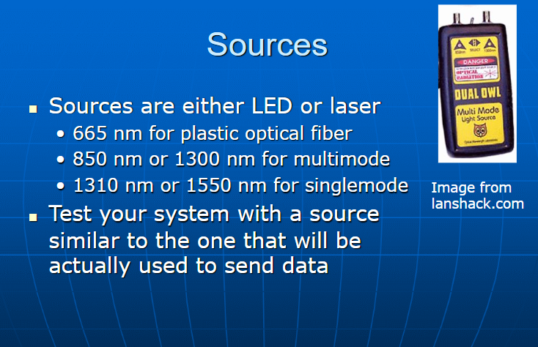

Slide 55
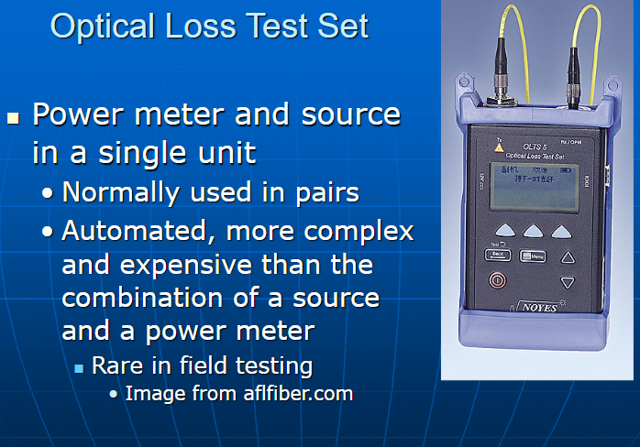

Slide 56
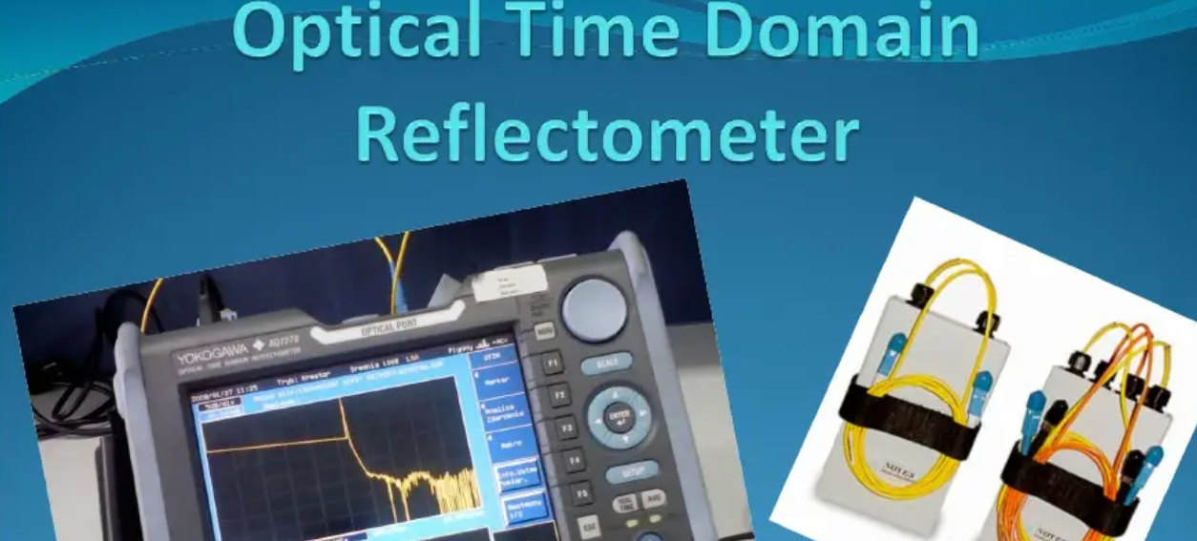

Slide 57
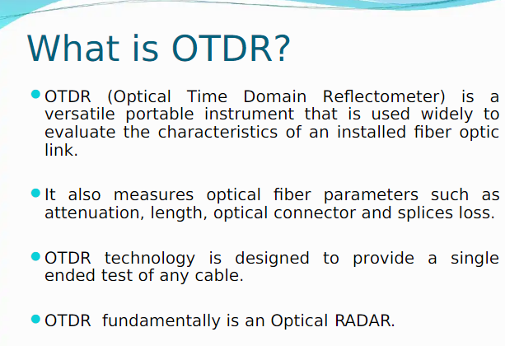

Slide 58
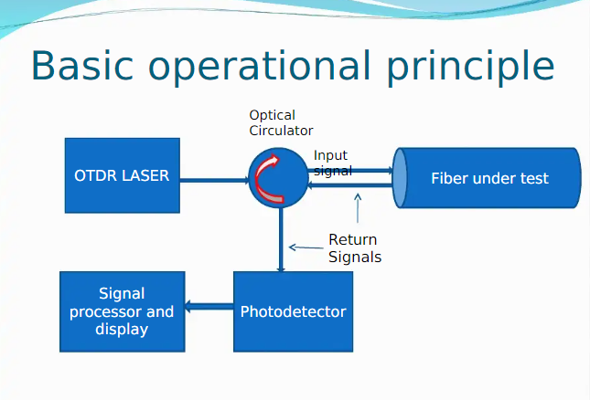

Slide 59
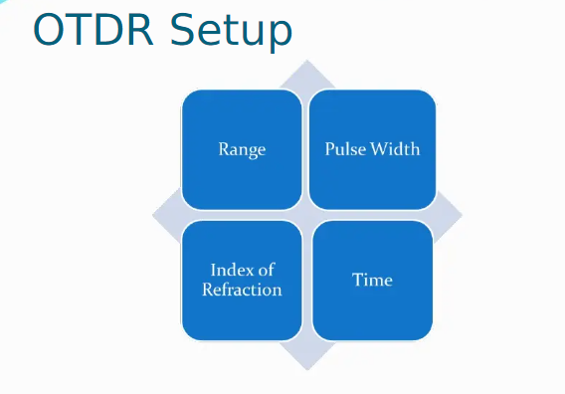

Slide 60
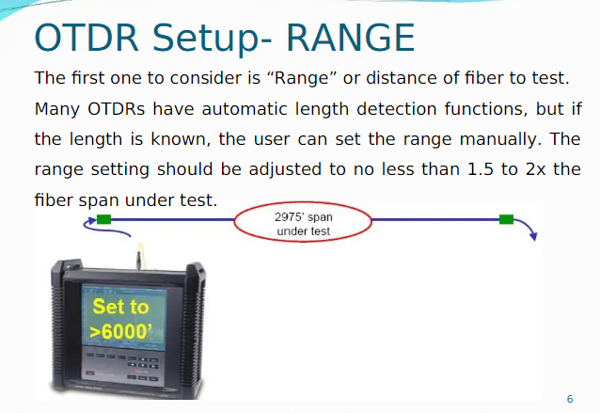

Slide 61


Slide 62


Slide 63


Slide 64


Slide 65


Slide 66


Slide 67


Slide 68


Slide 69


Slide 70


Slide 71


Slide 72


Slide 73


Slide 74


